Slide 1
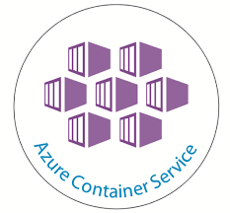
Azure Container Services
Sonu Sathyadas

Slide 2
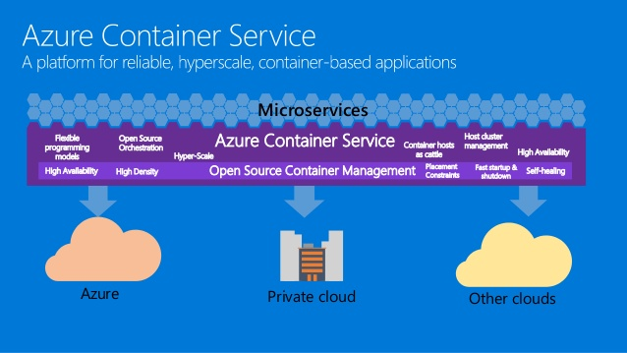

Slide 3
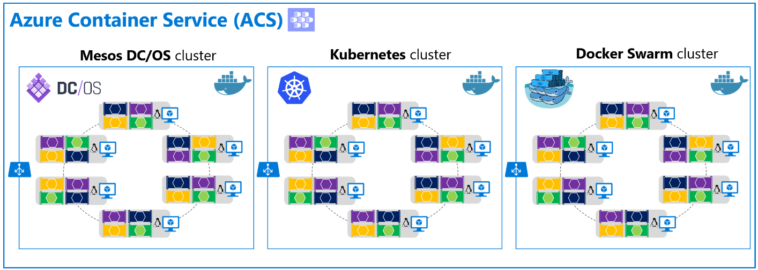
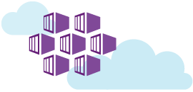
Orchestrators for ACS

Slide 4
Kubernetes
The orchestrator

Slide 5
Kubernetes
Open-source platform for automating deployment, scaling, and operations of application containers across clusters of hosts
Originally designed by Google.
Supports apps that runs in production
Service naming and discovery
Load balancing
Application health checking
Horizontal auto-scaling
Rolling updates.

Slide 6
Key terms
Node
Cluster
Deployment
Pods
ReplicaSet/Replication Controller
Services
Secrets
Kubernetes Manifest file (YAML/JSON file)

Slide 7
Pods
A pod is a group of one or more containers, the shared storage for those containers, and options about how to run the containers.
A pod’s contents are always co-located and co-scheduled, and run in a shared context.
A pod models an application-specific “logical host” - it contains one or more application containers which are relatively tightly coupled
Containers deployed inside pod see other containers via localhost.
Each pod has a unique IP address within the cluster.

Slide 8
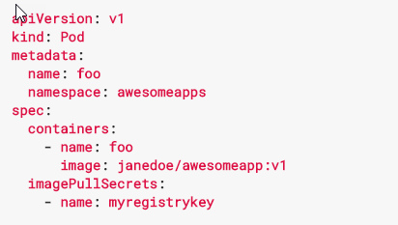
POD YAML Sample
Notes:
Pod pulls the image and create a single pod but does not create replicas. It does no contains the config for specifying the number of replicas.

Slide 9
ReplicaSet (NEW)/Replication Controller (OLD)
Handles replication and scaling by running a specified number of copies of a pod across the cluster.
Also responsible for pod replacement if the underlying node fails.

Slide 10
ReplicaSet VS ReplicationController
Replica Set supports the new set-based selector. This gives more flexibility.
Eg: Environment in (production, qa).
rollout command is used for updating the RS.
Even though replica set can be used independently, it is best used along with deployments which makes them declarative
Replication Controller only supports equality-based selector
Eg: environment=production
rolling-update command is used for updating the RC.
This replaces the specified replication controller with a new replication controller by updating one pod at a time to use the new PodTemplate.

Slide 11
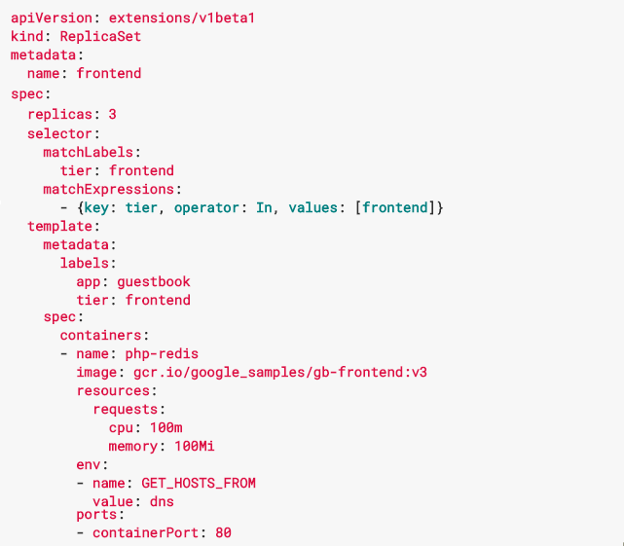
ReplicaSet YAML sample

Slide 12
Deployment
A Deployment provides declarative updates for Pods and ReplicaSets.
Only need to describe the desired state in a Deployment object
Deployment controller will change the actual state to the desired state at a controlled rate.
Define Deployments to create new ReplicaSets, or remove existing Deployments and adopt all of their resources with new Deployments.

Slide 13
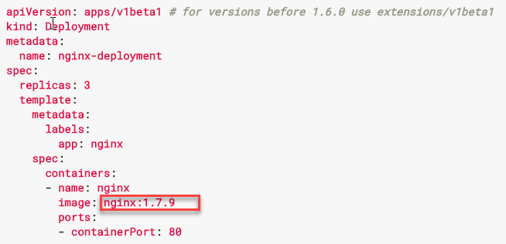
Deployment YAML sample

Slide 14
Services
Kubernetes Pods are mortal. They are born and when they die, they are not resurrected.
ReplicationControllers in particular create and destroy Pods dynamically.
While each Pod gets its own IP address, even those IP addresses cannot be relied upon to be stable over time.
A Kubernetes Service is an abstraction which defines a logical set of Pods and a policy by which to access them - sometimes called a micro-service.
The set of Pods targeted by a Service is (usually) determined by a Label Selector
Notes:
ReplicationControllers in particular create and destroy Pods dynamically (e.g. when scaling up or down or when doing rolling updates).
As an example, consider an image-processing backend which is running with 3 replicas. Those replicas are fungible - frontends do not care which backend they use. While the actual Pods that compose the backend set may change, the frontend clients should not need to be aware of that or keep track of the list of backends themselves. The Service abstraction enables this decoupling.
For Kubernetes-native applications, Kubernetes offers a simple Endpoints API that is updated whenever the set of Pods in a Service changes. For non-native applications, Kubernetes offers a virtual-IP-based bridge to Services which redirects to the backend Pods.

Slide 15
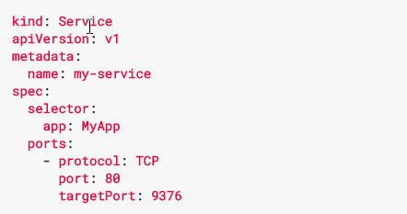
Service YAML sample

Slide 16
Secrets
Secrets are intended to hold sensitive information, such as passwords, OAuth tokens, and ssh keys.
Putting this information in a secret is safer and more flexible than putting it verbatim in a pod definition or in a docker image.
Suitable while accessing private repositories – store repository login credentials.

Slide 17
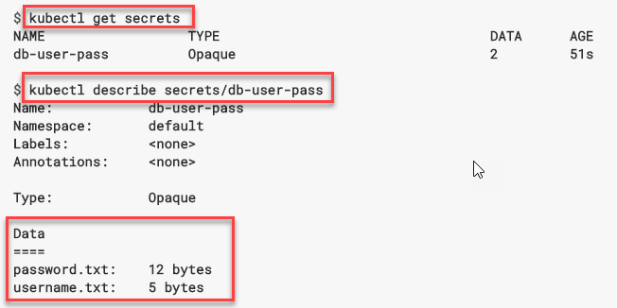
Creating secrets
kubectl create secret generic db-user-pass --from-file=./username.txt --from-file=./password.txt
Creates a secret object that contains two files.

Slide 18
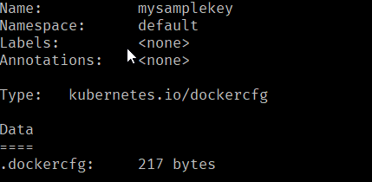
Create secrets
kubectl create secret docker-registry mysamplekey --docker-server=syndemoregistry.azurecr.io --docker-username=syndemoregistry --docker-password=5//b=aG3Oo+/+ZBQhQSXCc=FEHA/Fv9w --docker-email=sonusathyadas@hotmail.com
Creates a docker registry for storing login credentials. (eg: Azure Container Registry)

Slide 19
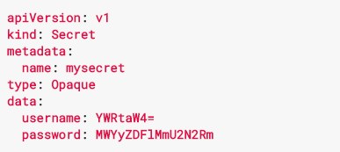
Secret YAML Sample

Slide 20
Terminology
Node: A single virtual or physical machine in a Kubernetes cluster
Cluster: A group of nodes firewalled from the internet, that are the primary compute resources managed by Kubernetes.
Edge router: A router that enforces the firewall policy for your cluster. This could be a gateway managed by a cloud provider or a physical piece of hardware.
Cluster network: A set of links, logical or physical, that facilitate communication within a cluster according to the Kubernetes networking model.
Service: A Kubernetes Service that identifies a set of pods using label selectors. Unless mentioned otherwise, Services are assumed to have virtual IPs only routable within the cluster network.

Slide 21
Ingress
Typically, services and pods have IPs only routable by the cluster network. All traffic that ends up at an edge router is either dropped or forwarded elsewhere.
An Ingress is a collection of rules that allow inbound connections to reach the cluster services.
It can be configured to give services externally-reachable urls, load balance traffic, terminate SSL, offer name based virtual hosting etc.

Slide 22
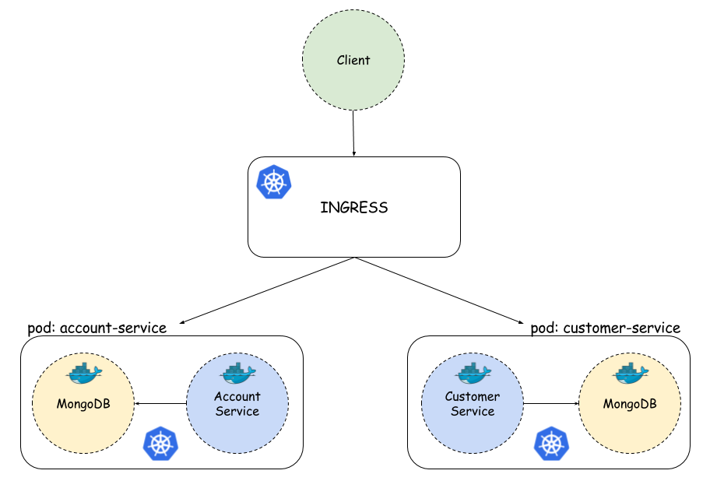
Ingress

Slide 23
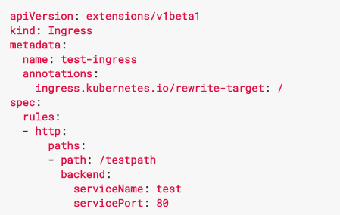
Ingress manifest YAML

Slide 24
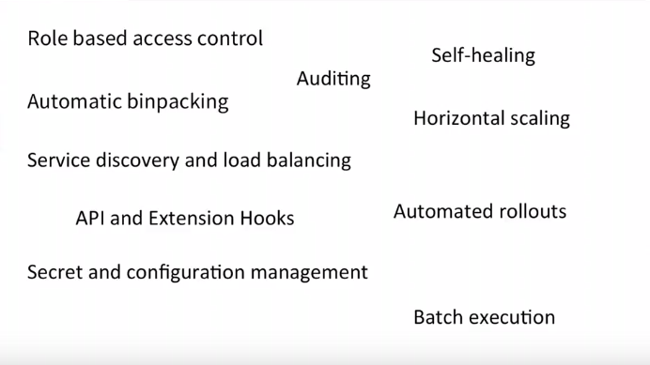
Kubernetes Features

Slide 25
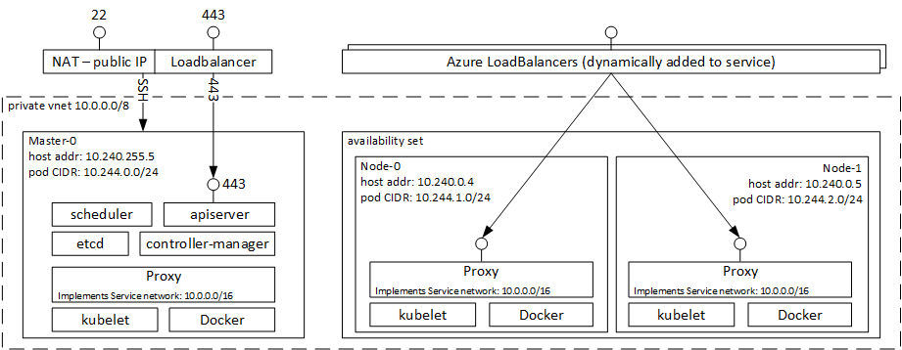
Kubernetes Master-Agent

Slide 26
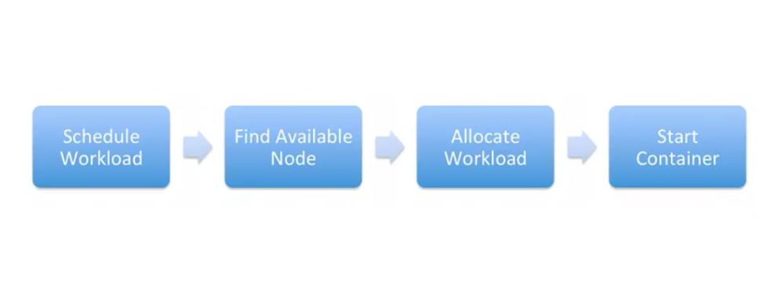
Kubernetes deployment stages

Slide 27
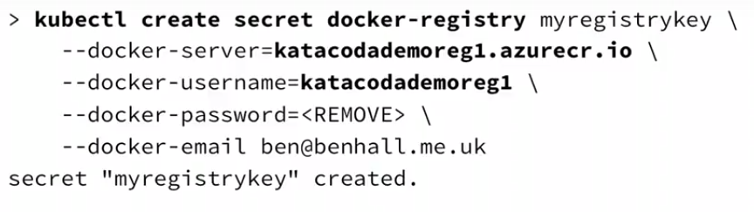
Create secret key

Slide 28
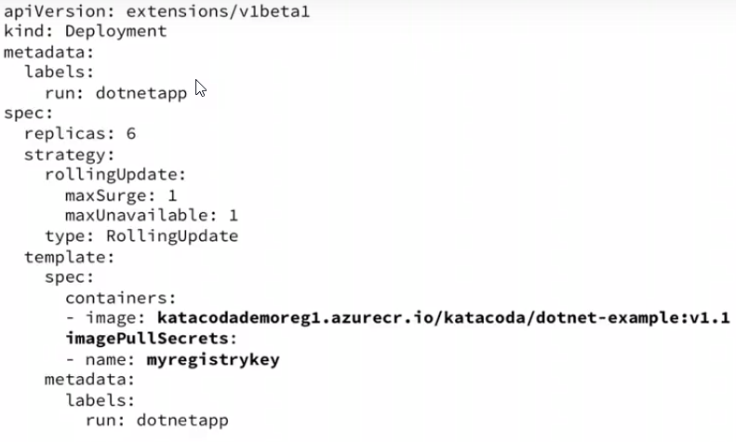
Pull image from ACR with secret key

Slide 29
Autoscaling aka HorizontalPodAutoscalers
Automatically scale pods as needed
Based on the resource utilization
Periodically queries the CPU for utilization for Pods it targets
CPU utilization on pods must be defined
kubectl autoscale deployment sample --min=2 --max=10 --cpu-percent=70

Slide 30
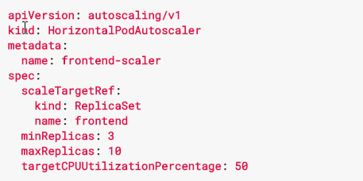

Slide 31
Kubectl run
run will start running 1 or more instances of a container image on your cluster.
kubectl run myapp --image=myrepo/myimage:latest \
--requests=cpu=500m,memory=500M --expose --port=80

Slide 32
Kubectl expose
expose will load balance traffic across the running instances, and can create a HA proxy for accessing the containers from outside the cluster.
kubectl expose deployment sample --type=LoadBalancer \
--port=80 --target-port=8089

Slide 33
Thank You
Sonu Sathyadas

